Slide 1

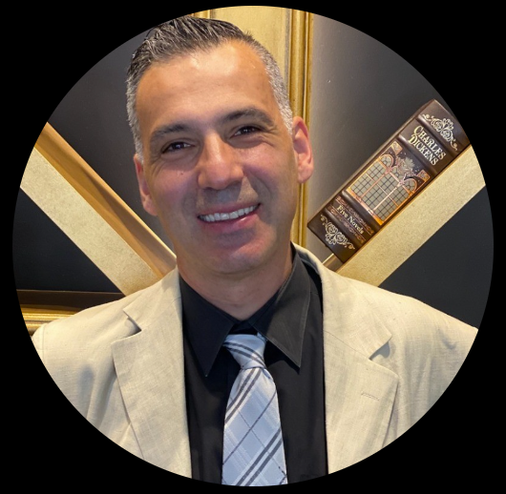
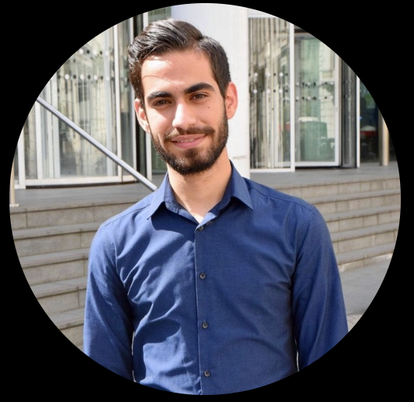
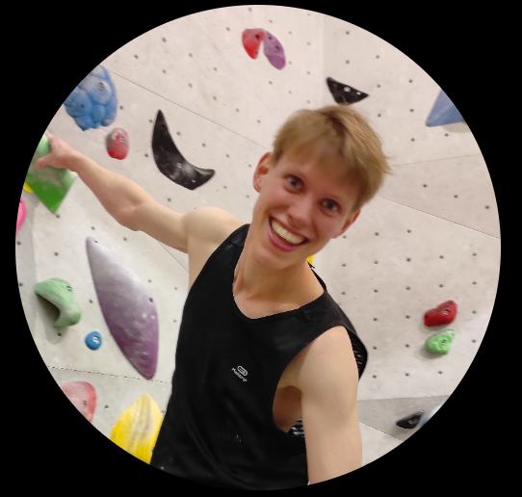
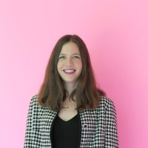
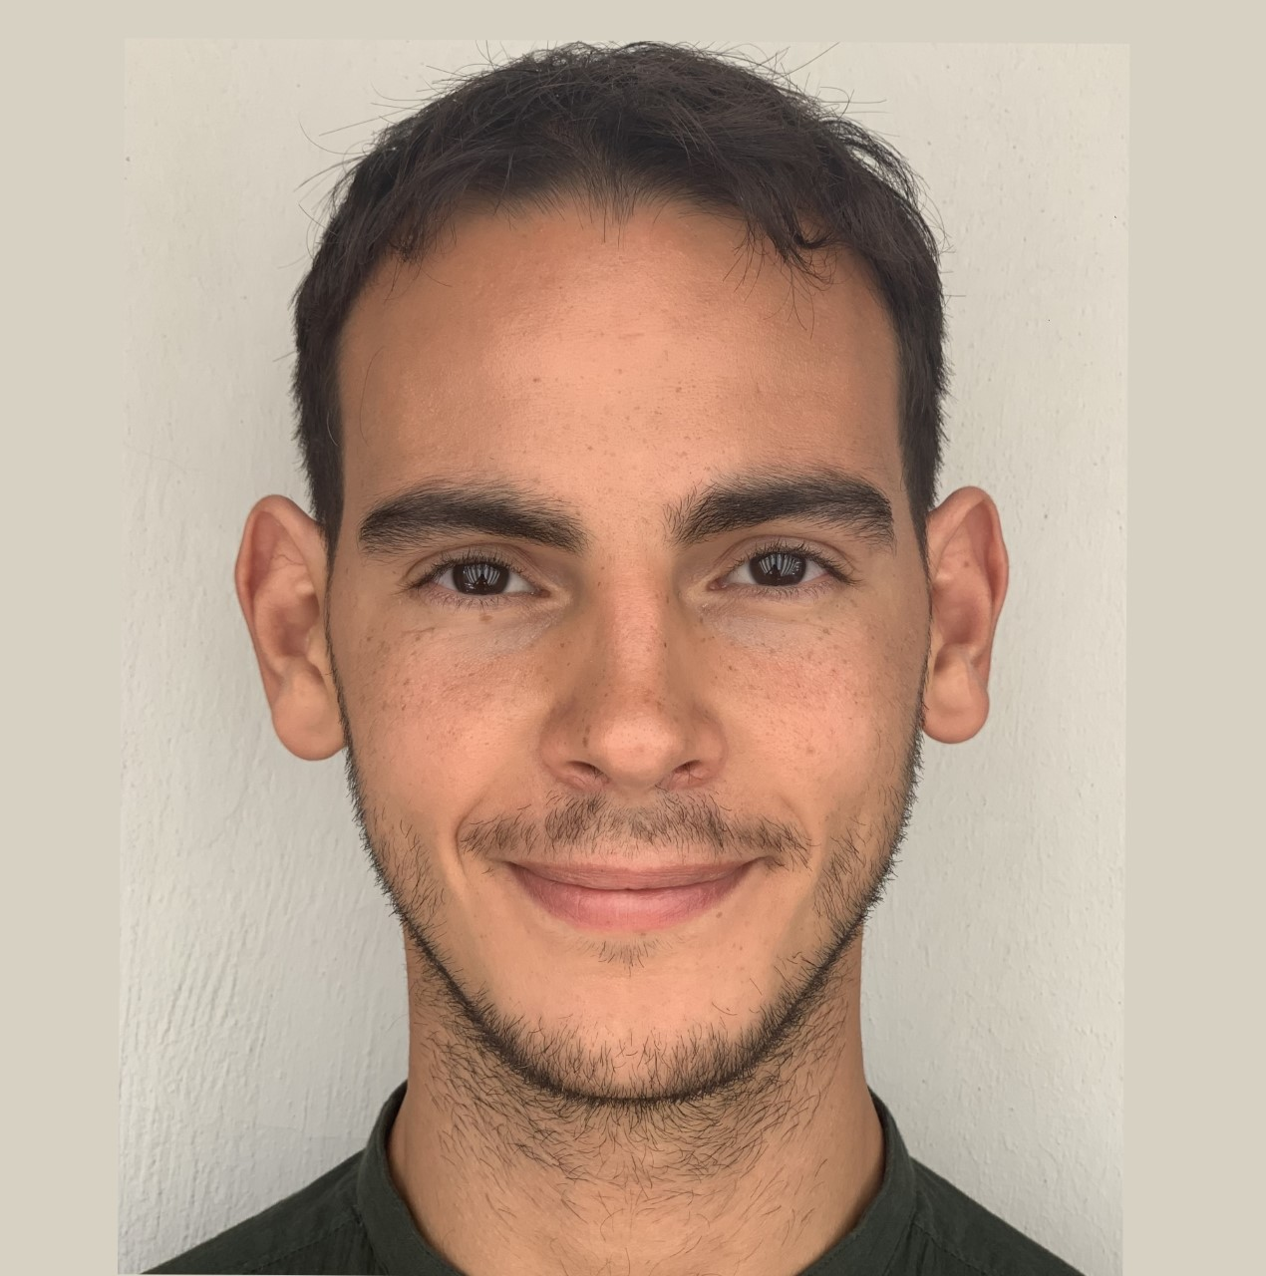
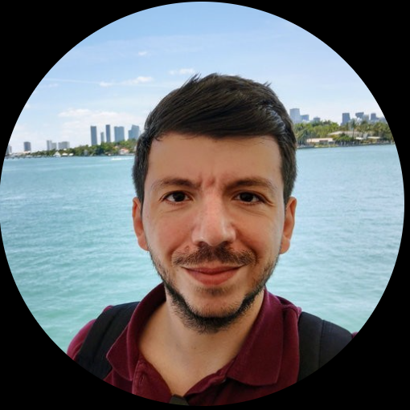
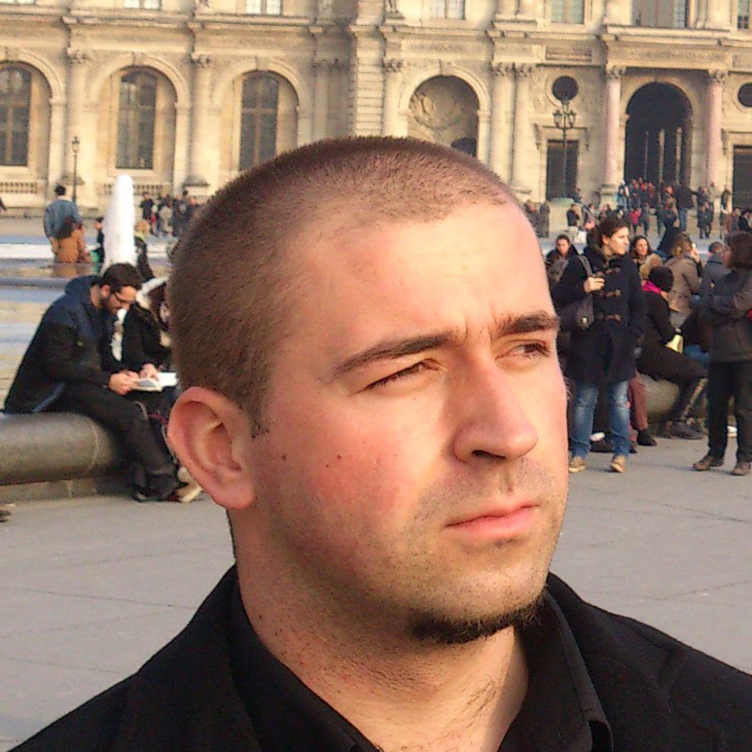
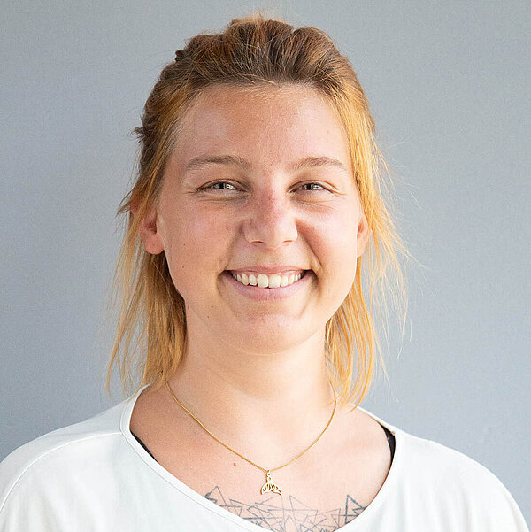
Meet the team
Meet the Team
Constantine Dovrolis
Christodoulos Stylianou
Robert Jan Schlimbach
Sophia Honisch
Ivan Gentile
Charalambos Chrysostomou
Boris Velichkov
Miriam Koch
Notes:
© Copyright Showeet.com – Free PowerPoint Templates

